Slide 1
Predicting Fatal Traffic Accidents Involving a Distracted Driver Springboard Capstone Project
Marilyn Roth
January 2017

Slide 2
Overview
Study Context
Study Objectives
Dataset
Data Wrangling
Exploratory Data Analysis
Model Building Process
Results
Insights & Recommendations
Future Research

Slide 3
Study Context
Traffic fatalities unexpectedly increased 7.2% in 2015
Distracted driving is a potential contributor to this increase
Smartphone ownership among Americans has quadrupled since 2010 to over 207 million people

Slide 4
Study Context (2)
Car insurance companies are always competing for new customers
Advancements in vehicle technology and the rise of ”big data” enable these companies to assess risk more accurately than ever
Car insurance companies are beginning to
Design insurance plans based on driving habits
Use driver data to assess liability in accidents (emerging area!)

Slide 5
Study objectives
To predict …
factors associated with fatal accidents involving a distracted driver
the actual incidence of fatal accidents involving a distracted driver

Slide 6
The Dataset
The National Highway Traffic Safety Administration 2015 US Traffic Fatalities dataset
32,167 observations involving at least one traffic related fatality
38 variables (all discrete integers apart from number of fatalities)
csv format

Slide 7
Data wrangling
Recoded all discrete integers to factors for the exploratory data analysis
Reduced the dataset to only variables used in the modeling
Recoded all factors into dummy variables to perform tests and analyses that cannot be run on categorical variables

Slide 8
Exploratory data analysis
The distribution of the outcome variable, traffic fatalities involving a distracted driver, is highly unbalanced in this dataset, with an overall incidence of less than 10%.
Distracted Driver | N | %
Yes | 3,196 | 9.9%
No | 28,970 | 90.1%

Slide 9
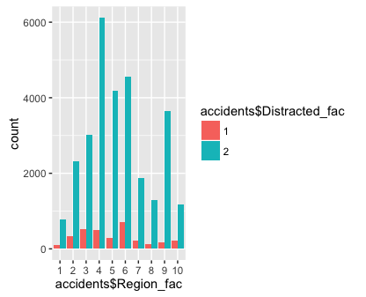
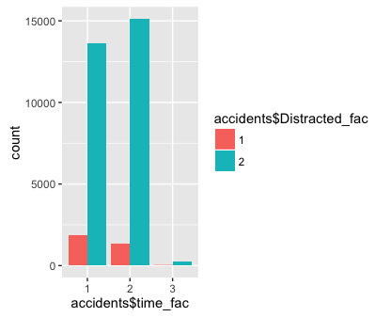
Exploratory data analysis
Distracted driving fatalities varied by many factors: (limited selection displayed here)
Most distracted driving fatalities occurred…
in Louisiana, Mississippi, New Mexico, Oklahoma, and Texas (region 6)
during the daytime (category 1)

Slide 10
Model building process
To begin I produced a logistic regression model predicting the likelihood of a fatal accidents involving a distracted driver (yes, no) that included 20 independent variables
I then simplified the model by removing all independent variables that were not statistically significantly associated with distracted driving
I also checked that none of the remaining variables were collinear using Variance Inflation Factor testing

Slide 11
Model building process (2)
I then built, trained and tested a logistic regression* model and a random forest model as constructed here:
Distracted_driver ~ ManCol_NoOthCar+motorcycle_Yes+RoadDeparture_Yes+Roll_Yes+speeding_Yes+
DriverUn25_Yes+Alcohol_Yes+Daytime+ManCol_RearEnd+Region_midAtlantic+
Region_SouthEast+Region_NorthMidwest+Region_CoNvNdSdWyUt+
Region_AZ_CA_HI+Region_PacificNW
*The Logistic Regression model also included a feature engineered interaction between daytime & rear end collision
Each model was trained and tested on a random 70/30 split of the dataset.

Slide 12
Results: associated factors
Logistic Regression results suggest variables associated with a traffic fatality involving a distracted driver…
(1) increased odds
daytime
rear end collision
pacific Northwest states
involving another vehicle
(2) decreased odds
Southeast and North Midwest states, Arizona, California, or Hawaii.
Involving a roadway departure
Involving speeding
Involving alcohol
Logistic Regression Model
McFadden pseudo R-squared
Training dataset
0.04681
Testing dataset
0.054700
The final logistic regression model was only able to explain approximately 4 to 5% of the variation in distracted driving fatalities. This is a poor model.

Slide 13
RESULTS: predicting incidence
Classic case of Accuracy Paradox…
The logistic regression model and the first random forest model had an overall accuracy rate of 90%!! Amazing! BUT WAIT! Remember that the distribution of distracted drivers was highly skewed.
Distribution of Distracted Drivers in the Dataset
The model learns that it can produce a 90% overall accuracy rate by never predicting a traffic fatality involving a distracted driver. The model has a 0% accuracy rate for predicting true positives.
What can we do? Let’s try smote
Distracted Driver | N | %
Yes | 3196 | 9.9%
No | 28970 | 90.1%

Slide 14
RESULTS: Predicting incidence (2)
Smote is an R package that over samples rare events that occur less than 15% of the time
Now the random forest model only has a 65% overall accuracy rate, but more importantly it predicts distracted driving fatalities.
How accurately does the model predict each quadrant?
Actual | Predicted | Rate
 | True positive | 1 predict 1
958 | 507 | 53%
 | False positive | 0 predict 1
8691 | 2902 | 33%
 | True negative | 0 predict 0
8691 | 5789 | 67%
 | False negative | 1 predict 0
958 | 451 | 47%
 | Predicted
Actual | 0 | 1
0 | 5789 | 2902
1 | 451 | 507
65% overall accuracy rate
This is much better than making a random guess, where one could only hope to achieve a rate of 50% at best.

Slide 15
Insights & recommendations
Car insurance companies could use this model …
to predict whether a fatal crash did not involve a distracted driver.
Reasoning: Evidence like this could help reduce the burden of liability and potentially save the driver and insurance company money in a settlement. As it currently stands, it is too risky to use this model to predict a fatality involving a distracted driver with adequate confidence, as the model had a false positive rate of 33%.
to develop more innovative, individualized, and competitive insurance premiums
Reasoning: Earlier findings from the study identified some subgroups of drivers as well as other conditions that may be associated with a lower likelihood of distracted driving accidents. These targeted premiums should incentivize safe driving (through lower premiums), which could also help reduce traffic fatalities.

Slide 16
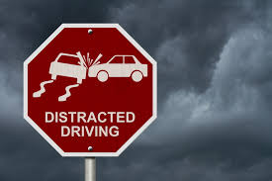
Future research
Combine multiple years of data
Include more variables
Produce similar models predicting other outcomes
Develop more feature engineered variables

Slide 17
Thank you

